Slide 1
Cancer Biology Biol 445
Spring 2020
Dr. Heidi Super
Lecture 20
3-13-2020

Slide 2
Return quiz

Slide 3
Where were we?
We had finished up TS genes—gatekeepers
Introduced/reintroduced TS genes—caretakers
DNA repair system genes
Mitosis regulating genes
Loss of function in these genes leads to genomic instability. Chromosome breaks, fusions, losses, and aneuploidy

Slide 4
Now that we’ve looked at so many genes of various types, let’s rethink how gene mutations accumulate in a cell, leading to its transformation.
Tumor progression is the result of new mutations occurring in a cell that has already acquired several mutations dysregulating cell division.

Slide 5
Most cancers show a rather slow progression to full blown malignancy. In many cases, the steps of progression are similar.
Many cancers have a “pre-cancer” phenotype which alerts physicians to intervene.

Slide 6
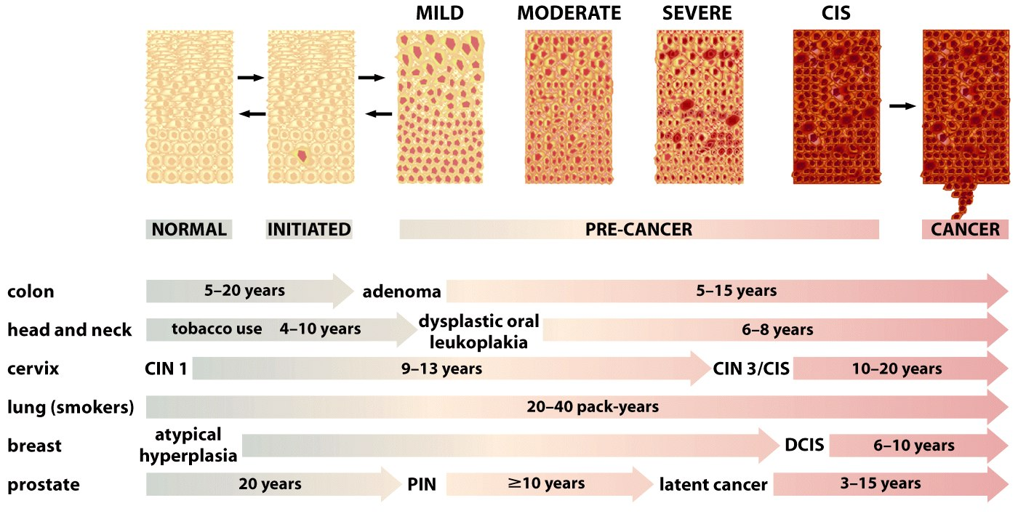
Figure 11.7 The Biology of Cancer (© Garland Science 2007)

Slide 7
Colon cancer provides one of the best models to illustrate how tumor progression can be marked by new genetic changes in one cell in a developing tumor.
10-19

Slide 8
How are the genes identified? How can a specific order be determined?
Biopsy tissue compared to normal cells from elsewhere in the same individual.

Slide 9
In many cases, a chromosome/DNA change was noted. (Often by cytogenetic/karyotype analysis).
Advances in molecular biology techniques allowed deeper “dissection” of the chromosome change until a gene was identified.
Further advances allowed identification of the function of the gene product.

Slide 10
Understanding genetic approaches
This approach is known as “Forward genetics” You start with a phenotype (i.e. colon cancer-–stage 3) and you look for mutations/DNA changes unique to this phenotype.
Phenotype Gene
LOH at Chromosome 17p—led to identification of p53 gene.

Slide 11
In contrast---many researchers use a “reverse genetics “ approach.
It starts with a random or semi-specific mutagenesis approach. i.e. Allow transposons to insert randomly all over the genome.
Then, the researcher screens for the phenotype of interest i.e. drug resistance, cell changes associated with metastasis, loss of sensitivity to apoptosis signal…
Phenotype Gene

Slide 12
Reverse genetics approaches can only be done in cell culture or in laboratory animals, but the results can be confirmed by analyzing biopsied tissue from humans.

Slide 13
Return to viruses (Chapter 7 and 4)
Recall…cancer is primarily a somatic disease (not inherited).
AND
Not usually spread like an infectious disease {caused by another organism (pathogen)} in humans.

Slide 14
Proving a disease is caused by a pathogen originating outside the host:
Pathogen is found associated with the tissue that is affected by the disease
Pathogen can be isolated from all other potential disease-related factors
Pathogen can be reintroduced into a healthy susceptible organism and causes the same disease
The same pathogen is recovered from the newly infected organism.

Slide 15
These are known as…. Koch’s postulates
Robert Koch---first microbiologist to show some diseases were caused by bacteria.
E.g.—Black plague thought to be caused by unclean spirits, unclean living conditions, poverty, illiteracy, rats, fleas…
Caused by Yersina pestis, a bacterium whose life cycle requires a flea host. The flea lives on the rat, which lives in areas where poverty prevents clean environments…
Could not be proven without the ability to grow microorganisms in the laboratory.

Slide 16
Koch’s criteria are easy to put to the test in non-human animals.
Early tests showed animals (birds, rodents, amphibians) can/do harbor viruses which cause cancer.
Leukemia
Sarcoma
carcinoma
Lymphoma

Slide 17
Main method of linking viruses to cancer.
Extract tumor from an animal
Lyse the cells so no cells left intact
Transfer the lysate to a new healthy animal of the same species.
This cell-free substance selects for small organisms (like bacteria or viruses) and insures no intact cancer cells are transferred.
Sound familiar?.......

Slide 18
Keeps whole cells from being transmitted to new host.
Figure 3.2 The Biology of Cancer (© Garland Science 2007)

Slide 19
Peyton Rous’s work--1910
First to show a viral link to cancer in animals.
Virus came to be called Rous Sarcoma Virus (RSV)
Not the same as respiratory syncytial virus

Slide 20
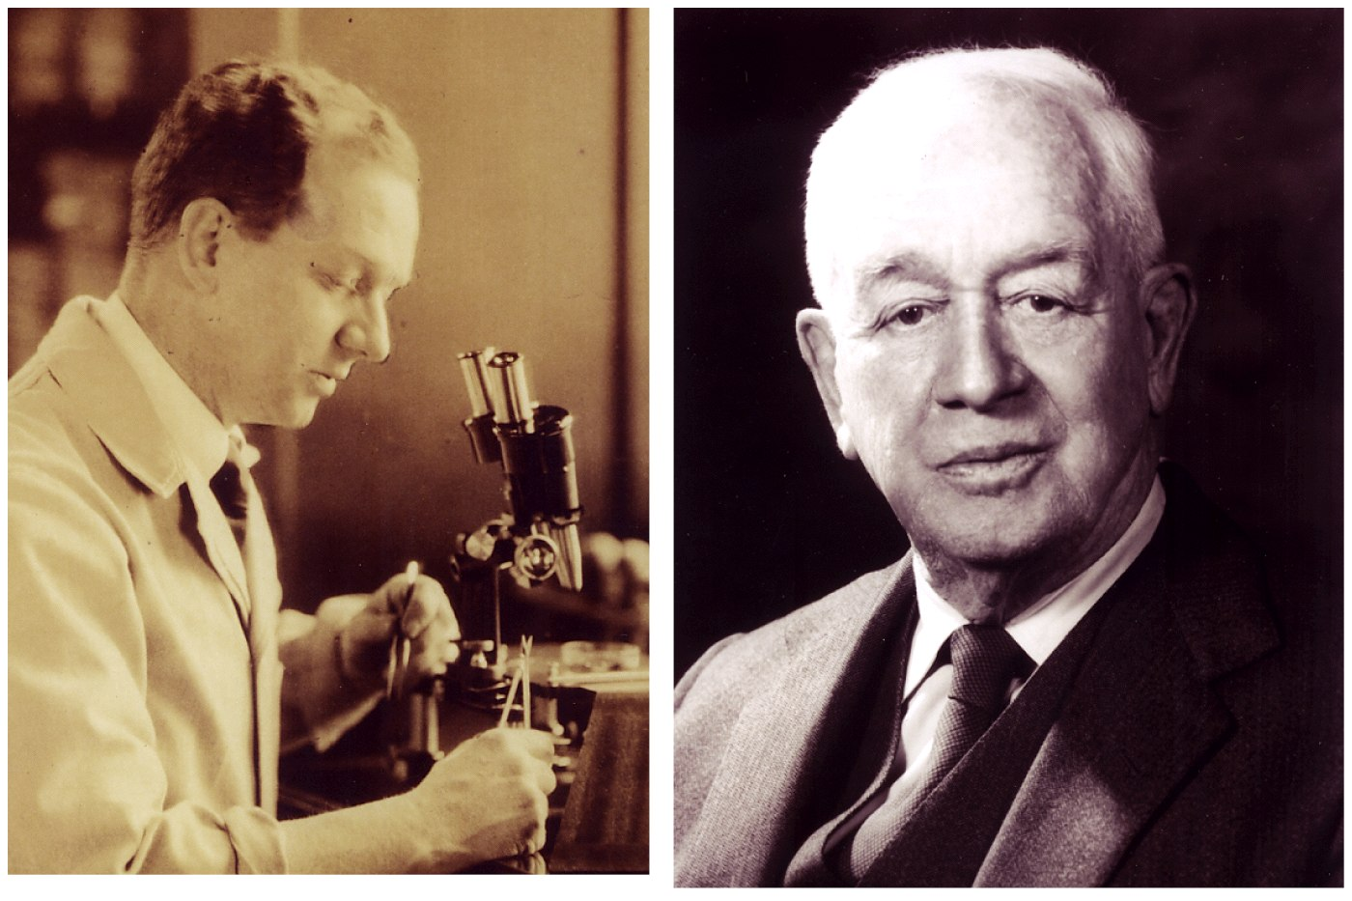
Figure 3.1 The Biology of Cancer (© Garland Science 2007)

Slide 21
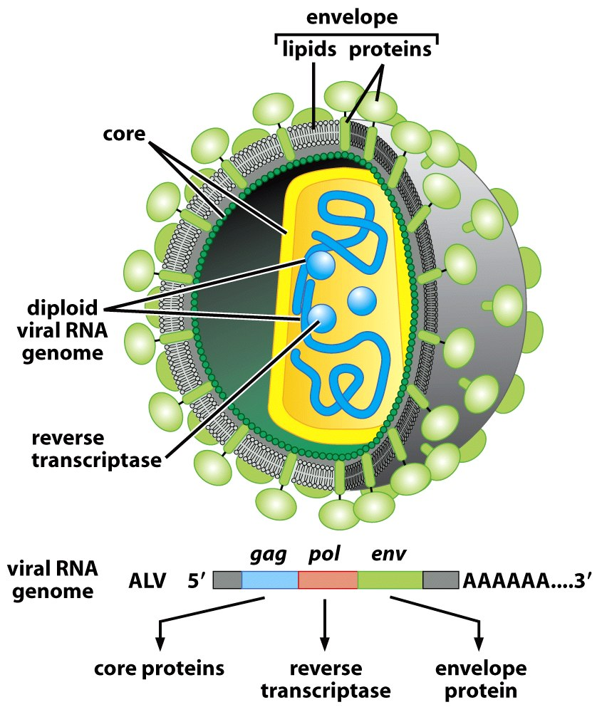
A typical retrovirus
Figure 3.4a The Biology of Cancer (© Garland Science 2007)

Slide 22
Koch’s criteria are not so easy to put to the test in humans. Why?
Initially…
Medical ethics—can’t infect human subjects with a potentially lethal agent
Lack of technology to detect infectious agents in naturally-occurring human cancers.

Slide 23
Eventually…
Even with molecular biology advances, allowing detection of genetic material from bacteria and viruses, few human cancers showed a link to pathogens.
exceptions:
HVP (only a few strains)
HTLV-1
Hepatitis B and Hepatitis C
Epstein Barr virus
Kaposi sarcoma virus
Bacterium—H. pylori
Parasitic worms– blood and liver flukes

Slide 24
Let’s continue with retroviruses
RSV originated when a chicken virus (avian leukosis virus—ALV) acquired he Src proto-oncogen from a specific chicken’s cell.

Slide 25
Figure 3.19 The Biology of Cancer (© Garland Science 2007)

Slide 26
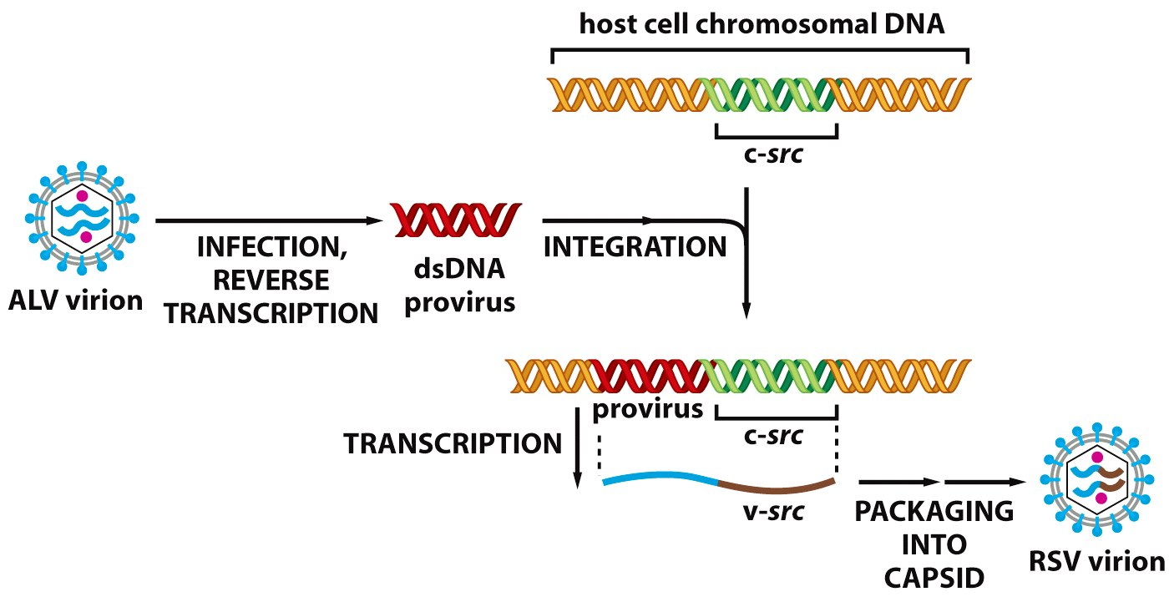
Mechanism?
Figure 3.22 The Biology of Cancer (© Garland Science 2007)

Slide 27
Figure 7-8,7-9,
Figure 7-10
Table 7-3

Slide 28
Amazing set of circumstances.
The creation of the RSV virus seems to have occurred only once in the 20th century!
All RSV descendants can be traced to a single chicken coop in 1909.
A farmer brought Rous a prize hen hoping he could cure her cancer!

Slide 29
Evidence?...
Genetic similarity of all RSV
Picking up additional genes usually decreases the ability of a virus to infect host cells. (That virus will die out quickly—will be lost from the population)

Slide 30
For oncogenic retroviruses to be maintained:
Someone (like Rous!) has to notice cancer in an animal and artificially propagate the virus!
The virus must gain something…e.g. an increased ability to infect a new host.

Slide 31
A second chicken virus, MC29, was also shown to be a modified ALV.
ALV acquired Myc (not Src) from the chicken cell.

Slide 32
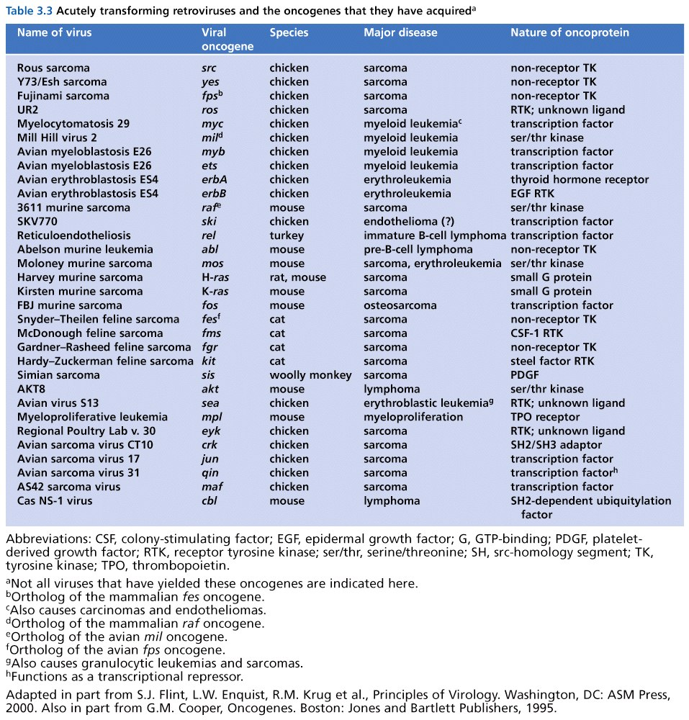

Slide 33
Food for thought…
All retroviruses that rapidly induce cancer in animals have been shown to have acquired a cellular oncogene.= acutely transforming retroviruses.
Without these viruses, the identification of protoncogenes would have been much more difficult! This is a recurring theme!

Slide 34
Some retroviruses induce cancer, but slowly. (after long-term infection).
Interestingly…these viruses do not contain cellular host genes.
Eventually, tumor cells were found to have retroviral insertion near cellular proto-oncogenes.

Slide 35
We’ve heard about this….
Insertion results in altered expression or altered mRNA/protein made by the proto-oncogene.
=Insertional Mutagenesis

Slide 36
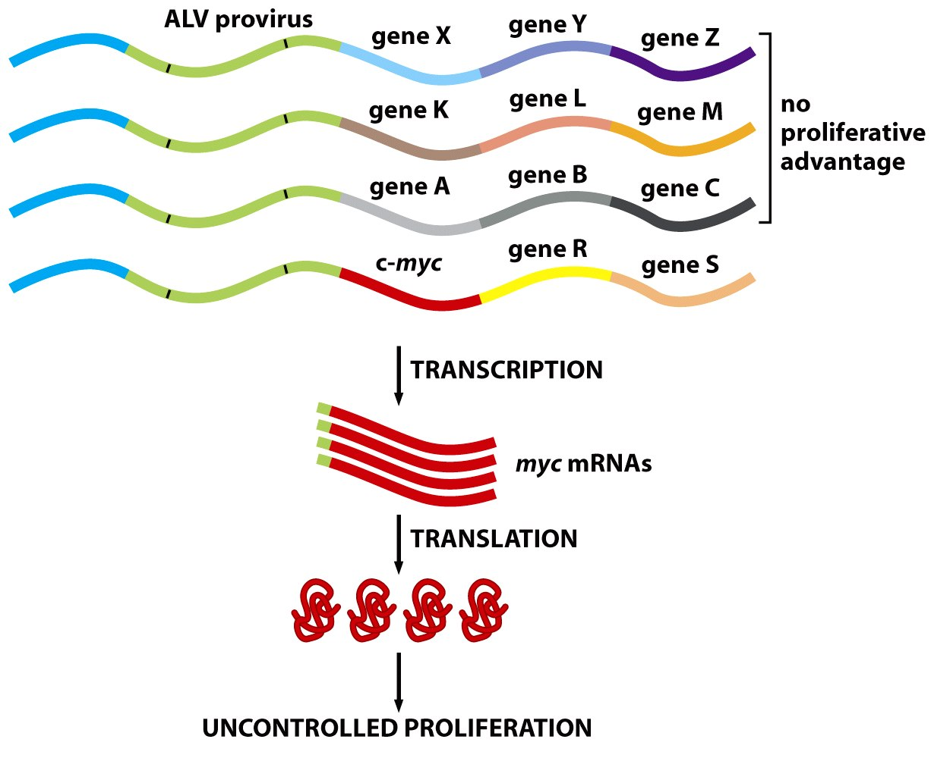
Figure 3.23b The Biology of Cancer (© Garland Science 2007)

Slide 37
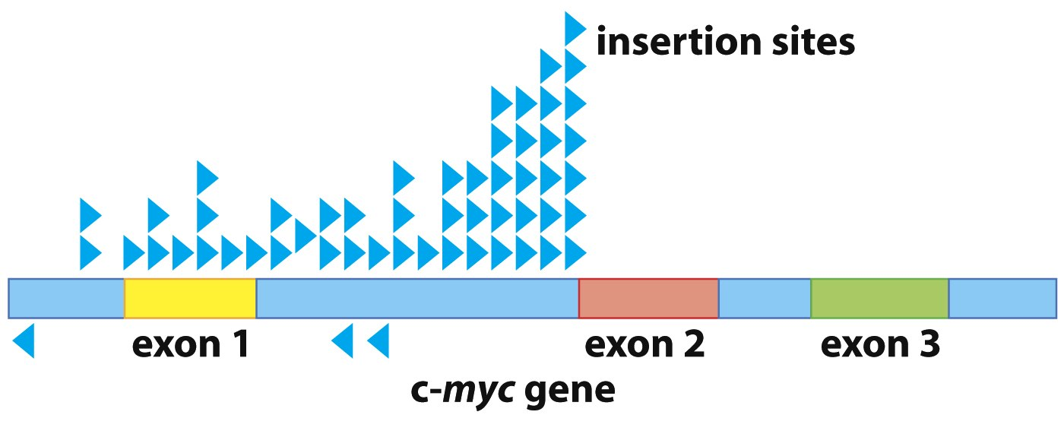
Certain sites of insertion to be more advantageous to the virus than other sites of insertion. Blue arrows indicate cancer causing viruses and where in the Myc gene the virus inserted.
Figure 3.23a The Biology of Cancer (© Garland Science 2007)

Slide 38
Isolation of DNA near the insertion site of retroviruses has allowed mapping of new, or previously identified proto-oncogenes.

Slide 39
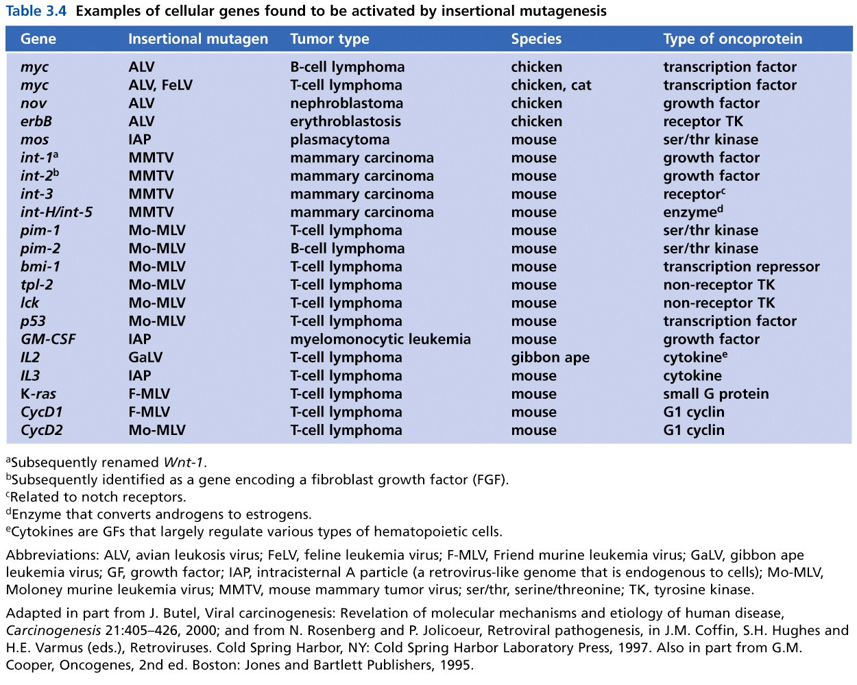
Table 3.4 The Biology of Cancer (© Garland Science 2007)

Slide 40
Variation in cancer viruses Table 7-1
Genome
RNA—retroviruses,
DNA (HPV)
Cancer specificity
Linked to one type of cancer
Linked to several tumor types
Activity
Immediate (acutely transforming)
Latent (long-term infection before cancer develops)

Slide 41
Some other viruses have a tight correlation to human cancers, but play an indirect role.

Slide 42
Epstein-Barr virus
~90% of people world-wide have been infected with EBV (Herpes family virus)
Associated with infectious mononucleosis
Readily infects lymphocytes
High correlation of EBV and Burkitt’s lymphoma (limited to equatorial Africa)
Found in ~50% of Hodgkin’s lymphoma (characterized by an unusual lymphocte)

Slide 43
A complicated link to human cancer
Burkitt’s lymphoma occurs where mosquitoes are abundant and malaria is prevalent.
Infection with malaria suppresses the immune system and likely allows EBV to proliferate and exert effects on cells, not possible in a human with robust immune response.

Slide 44
Clearly, most people who have been exposed to EBV do not develop lymphoma.
Having mononucleosis does slightly increase the risk for developing lymphoma, including Hodgkins lymphoma.

Slide 45
EBV also linked to head and neck cancers
Limited regionally (southeast Asia)
Nasophryngeal carcinoma (nose/throat)
Means that EBV is not entirely specific for lymphocyte infection. And that an environmental factor likely contributes to these cancers.

Slide 46
How do we link EBV (or any infectious agent) to cancer?
EBV genome/proteins found in the cancer cells, but not in other cells of the organism.
Remember---Cancer is nearly always as somatic, genetic disease. Mutations/cause is limited to the cancer cells.
And don’t forget Koch’s postulates

Slide 47
Molecular mechanism of EBV?
Unknown…
Likely indirect
Suppression of immune system
Inhibition of cancer-associated genes?
EBV expresses a protein which binds to a cellular protein Nm23H1. Nm23H1 inhibits migration of cells (belongs to a class of genes called metastasis-inhibitor genes.
Still being studied…

